Slide 1
DBMS Lock based protocol

Slide 2
Concurrency Control Protocol
Lock based protocol
Time-stamp protocol

Slide 3
Lock based protocol
In concurrent environment many users access same data simultaneously.
To achieve this ----- mutual exclusion
Whenever one transaction is accessing data second transaction should not change data otherwise there may be dirty read problem. this can be done using locking protocol.

Slide 4
Locking is necessary in concurrent environment to assure that one process should not retrieve or update a record which another process is updating.
Failure to this would result in inconsistent and corrupted data.

Slide 5
Types of lock
Shared lock
Exclusive lock

Slide 6
1. Shared Lock (S):
A shared lock is also called a Read-only lock. With the shared lock, the data item can be shared between transactions. This is because you will never have permission to update data on the data item.
For example, consider a case where two transactions are reading the account balance of a person. The database will let them read by placing a shared lock. However, if another transaction wants to update that account's balance, shared lock prevent it until the reading process is over.

Slide 7
Exclusive Lock (X):
With the Exclusive Lock, a data item can be read as well as written. This is exclusive and can't be held concurrently on the same data item. X-lock is requested using lock-x instruction. Transactions may unlock the data item after finishing the 'write' operation.
For example, when a transaction needs to update the account balance of a person. You can allows this transaction by placing X lock on it. Therefore, when the second transaction wants to read or write, exclusive lock prevent this operation

Slide 8
LOCK TABLE customer IN
SHARED MODE
LOCK TABLE customer IN
EXCLUSIVE MODE

Slide 9
There are three types of lock protocols available:
Simplistic lock protocol
Pre-claiming Lock Protocol
Two-phase locking (2PL)
1.Strict two phase locking protocol
2. Rigorous two phase locking protocol
3.Conservative 2P locking protocol(Static 2PL)

Slide 10
Simplistic lock protocol
It is the simplest way of locking the data while transaction.
Simplistic lock-based protocols allow all the transactions to get the lock on the data before insert or delete or update on it.
It will unlock the data item after completing the transaction.

Slide 11
Pre-claiming Lock Protocol
Pre-claiming Lock Protocols evaluate the transaction to list all the data items on which they need locks.
Before initiating an execution of the transaction, it requests DBMS for all the lock on all those data items.
If all the locks are granted then this protocol allows the transaction to begin. When the transaction is completed then it releases all the lock.
If all the locks are not granted then this protocol allows the transaction to rolls back and waits until all the locks are granted.

Slide 12
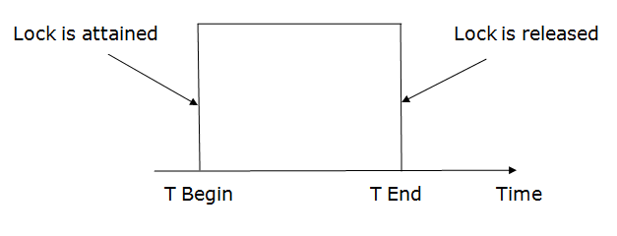

Slide 13
Two-phase locking (2PL)
The two-phase locking protocol divides the execution phase of the transaction into three parts.
In the first part, when the execution of the transaction starts, it seeks permission for the lock it requires.
In the second part, the transaction acquires all the locks. The third phase is started as soon as the transaction releases its first lock.
In the third phase, the transaction cannot demand any new locks. It only releases the acquired locks.

Slide 14
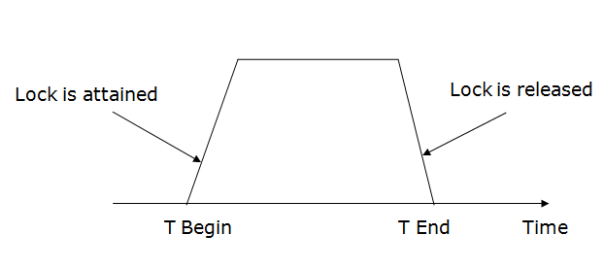

Slide 15
There are two phases of 2PL:
Growing phase: In the growing phase, a new lock on the data item may be acquired by the transaction, but none can be released.
Shrinking phase: In the shrinking phase, existing lock held by the transaction may be released, but no new locks can be acquired.
In the below example, if lock conversion is allowed then the following phase can happen:
Upgrading of lock (from S(a) to X (a)) is allowed in growing phase.
Downgrading of lock (from X(a) to S(a)) must be done in shrinking phase.

Slide 16
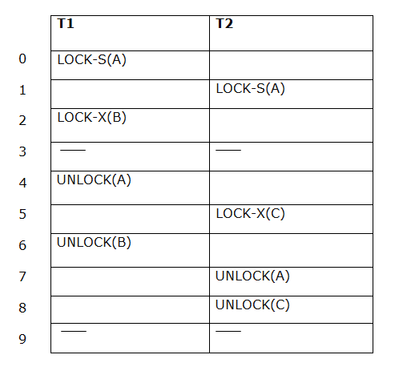

Slide 17
The following way shows how unlocking and locking work with 2-PL.
Transaction T1:
Growing phase: from step 1-3
Shrinking phase: from step 5-7
Lock point: at 3
Transaction T2:
Growing phase: from step 2-6
Shrinking phase: from step 8-9
Lock point: at 6

Slide 18
Versions of two phase locking protocol
1.Strict two phase locking protocol
2. Rigorous two phase locking protocol
3.Conservative 2P locking protocol(Static 2PL)

Slide 19
1. Strict Two-phase locking (Strict-2PL)
The first phase of Strict-2PL is similar to 2PL. In the first phase, after acquiring all the locks, the transaction continues to execute normally.
The only difference between 2PL and strict 2PL is that Strict-2PL does not release a lock after using it.
Strict-2PL waits until the whole transaction to commit, and then it releases all the locks at a time.
Strict-2PL protocol does not have shrinking phase of lock release.

Slide 20
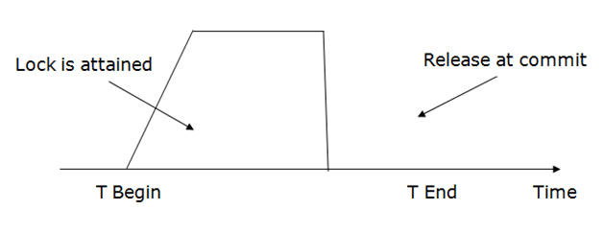

Slide 21
2. Rigorous two phase locking protocol
Avoids cascading rollbacks
It requires that all share and exclusive locks to be held until the transaction commits.
So transactions can be serialized in the sequence they commit.
Most of the database systems implement strict or rigorous two phase locking protocol.

Slide 22
3.Conservative 2P locking protocol(Static 2PL)
Also called as static 2P locking protocol.
This scheme requires locking all items needed to access before the transaction starts.
It begins execution by declaration about read set and write set of all data items needed in advance.
Read set: set of all data transactions lock.
Write set: set of all data than n-calls transactions lock.

Slide 23
If any one item of above list is currently not available for locking then lock will not be granted it waits till all items are ready for locking.
It is almost free from deadlocks as all required items are listed in advance.

Slide 24
Thank you !

